Slide 1
Are We Getting Results Yet?
The Board’s Role in Measuring and Monitoring Performance
United Way of Dane County
Leadership Development for Nonprofit Board Members Conference
November 5, 2016
Robin Gates

Slide 2
Session Objectives
The session should help you:
Understands the board’s role in monitoring performance.
Decide what to measure and monitor at the board level.
Be a more informed consumer of performance data.
Determine what to do after reviewing performance information.

Slide 3


Slide 4
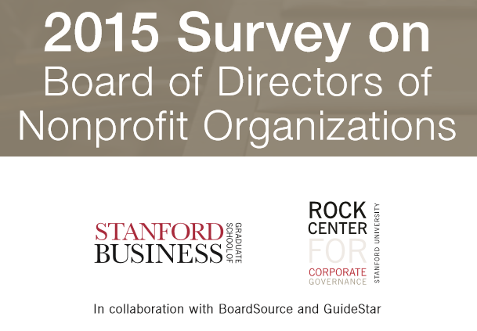
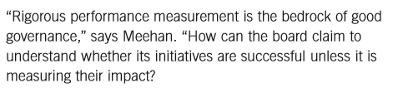


Why measuring performance is important
Governance
Improvement
Funders
Focus

Slide 5



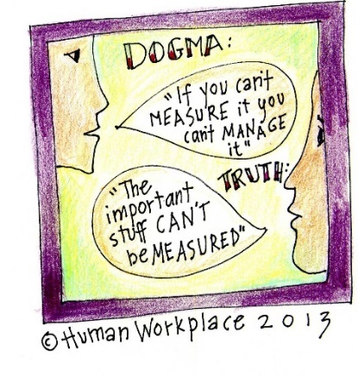

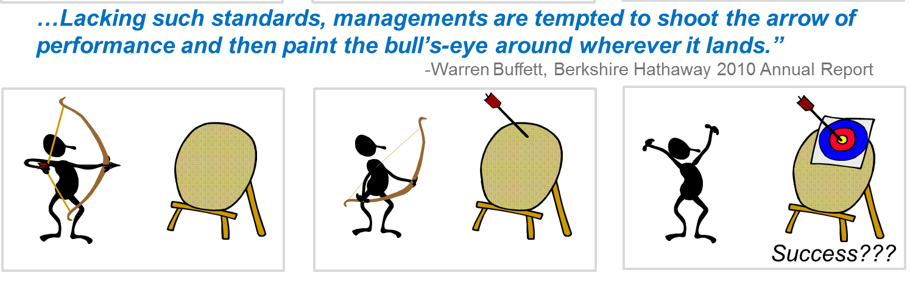

What performance measurement problems do you face?
Too much information?
Feel blind?
What do we do now?
Missing something?
Is trust enough?
No money
No agreement on standards?

Slide 6
The Board’s Role in Reviewing Performance
Governing
  Assuring the organization gets results (outcomes or ends)
  Assuring results are achieved in an acceptable manner (means or operations)
    Ethically
    Legally
    Sustainably
  CEO accountability for ends and means
Advising
  Helping solve organization problems
  Assisting the CEO
Operational Duties of the Board
  Fundraising
  Marketing
  Advocacy
  Planning
Board Member Development and Education
Ask:
  Why are we measuring or monitoring this?
  What actions will we take as a result?

Slide 7
Measurement and Board Governance

Slide 8
Logic Model for Performance Measurement
A logic model provides the causal linkage between what an organization does and the results or outcomes it achieves
Operational focus here
Board focus here

Slide 9
Defining Outcomes or Results
Outcomes or results describe the effect an organization seeks to have on the outside world. The organization exists only to produce worthwhile results.
Three practical questions
  Who should benefit?
  What are the benefits?
  What should it cost to achieve the benefits?
Guidelines for defining outcomes
  Separate activities and outputs from outcomes or results
  Avoid verbs that focus on means (help, provide, assist, and educate) or effort (support, endeavor)
  The recipient should be the subject.

Slide 10
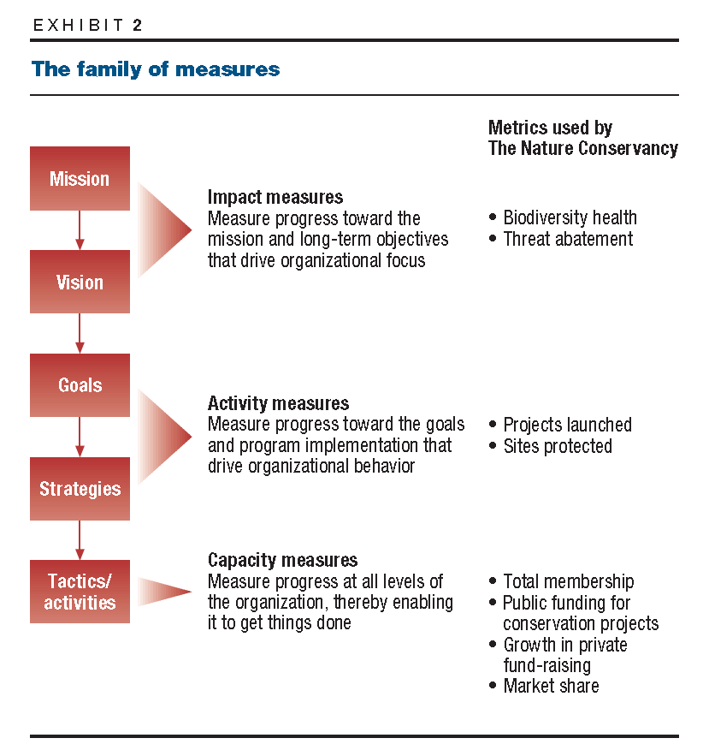
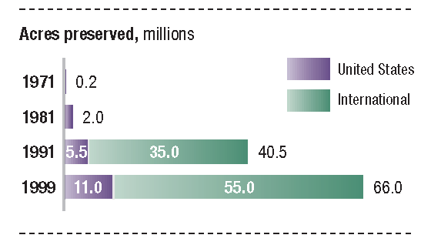
Case Study – Nature Conservancy

Slide 11
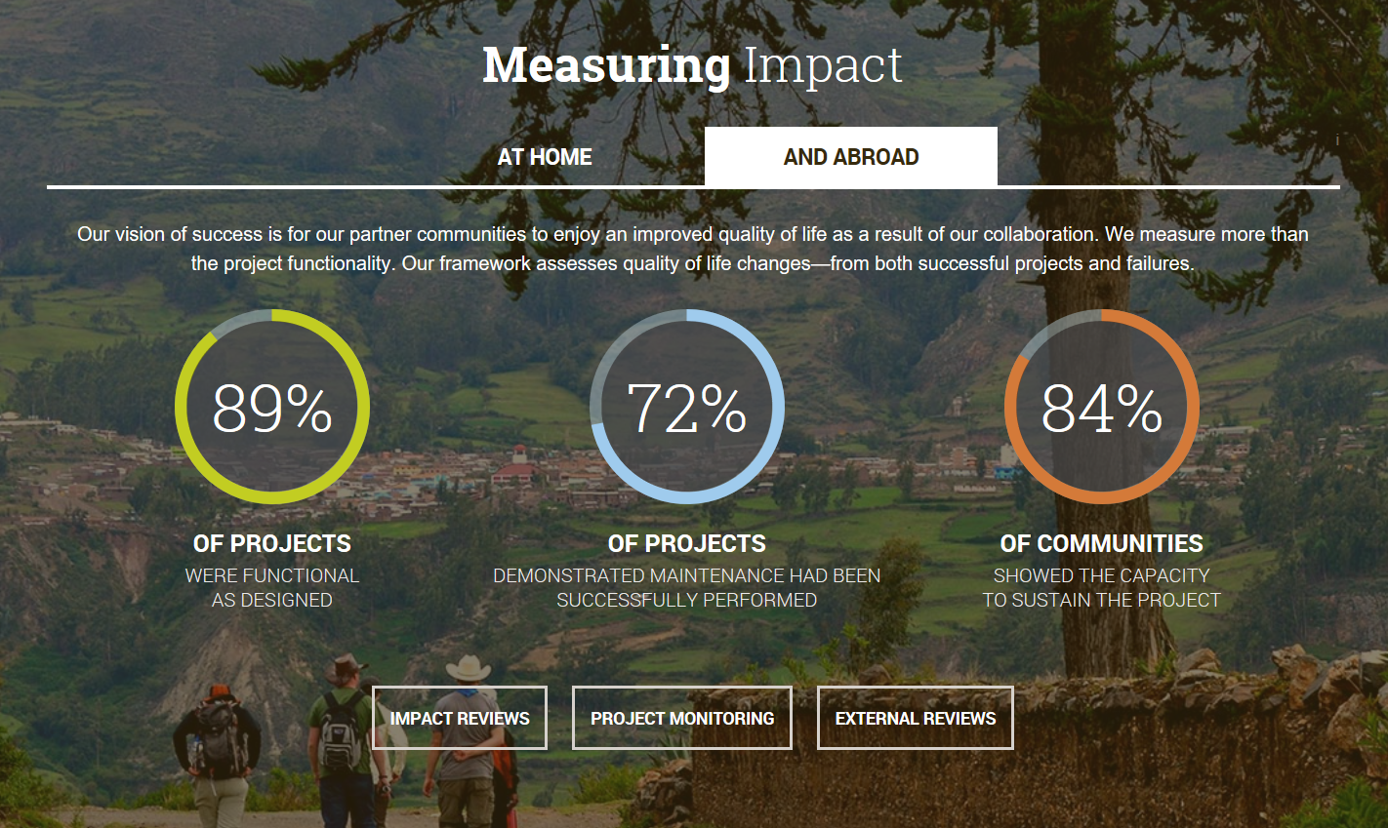
Case Study – Engineers Without Borders

Slide 12
The Monitoring Process
Establish desired outcomes or results – board agreement
Develop operational interpretation of outcomes (CEO)
  What does this mean in the real world
  What performance level is acceptable
Gather and review evidence regarding performance
Conclude whether outcome is being met or not
Board takes action as appropriate
  Accept report
  Accept report with qualifications or required actions

Slide 13
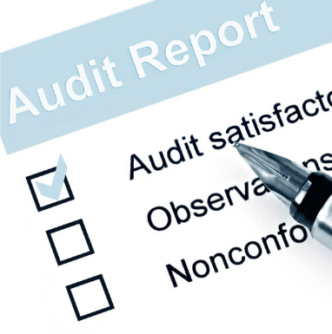



Monitoring Methods
Direct inspection by the board
CEO report
Independent audit
Policy Interpretation Evidence Compliance (yes/no) Acceptance/Action

Slide 14
Example - Outcomes

Slide 15
Board Monitoring of Operations Performance
Establish conditions or performance that are unacceptable
  Illegal
  Unethical
  Too risky
  Imprudent
CEO practical interpretation of limitations
Review performance
Board response as appropriate

Slide 16
Example – Operational Requirements

Slide 17
Performance and the Board-CEO Relationship
The board has one employee – the CEO
Organizational and CEO performance are one in the same
CEO performance should be assess against stated expectations
  No informal, verbal “understandings”
  Performance assessment should involve the entire board
Clear feedback and honest discussion is critical
  Formal response to performance monitoring reports
  Action plans required as needed
  Constructive dialog with the CEO
CEO performance is the board’s judgment aided by performance monitoring

Slide 18
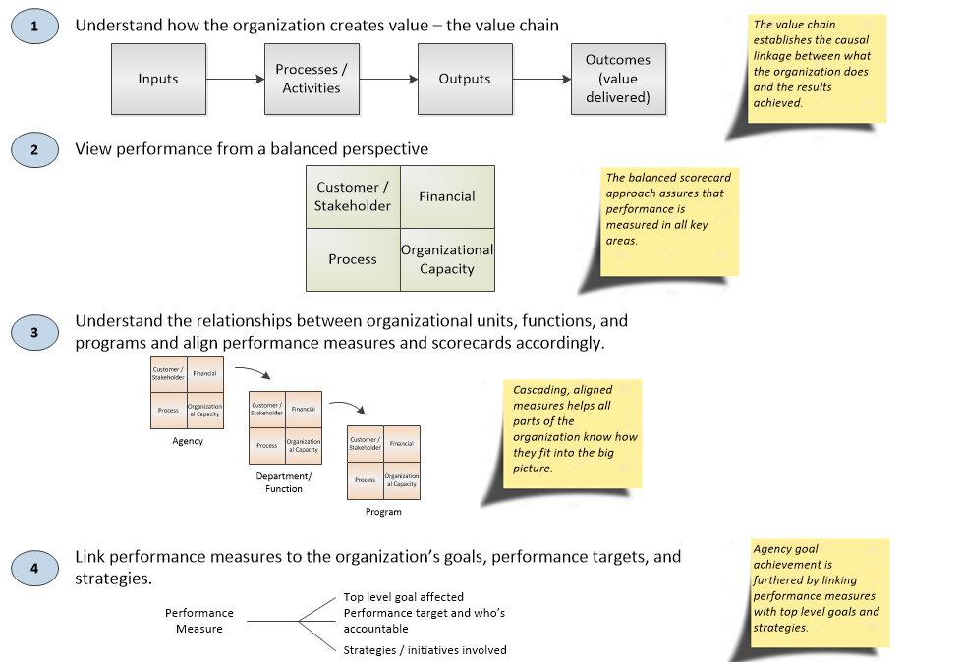
Perspectives in Measuring Performance

Slide 19
What can go wrong?

Slide 20
Take Aways
Measuring nonprofit performance is important, especially results
The board has a special role in monitoring performance
Success factors:
  Monitoring purpose is understood
  Approach is systematic and sustained
  Practical problems are acknowledged and addressed
  Board and CEO leadership

Slide 21
Resources:
  My website: www.robingates.net/nonprofit-board-governance/
  Guidestar Platinum Program: https://learn.guidestar.org/platinum
  Leap of Reason website: http://leapofreason.org/
  Carver website: www.policygovernance.com
  BoardSource: www.boardsource.org

